Slide 1
2.1 Origins and Evolution of HTML
- HTML was defined with SGML
- Original intent of HTML: General layout of
documents that could be displayed by a wide
variety of computers
- Recent versions:
- HTML 4.0 – 1997
- Introduced many new features and deprecated
many older features
- HTML 4.01 - 1999 - A cleanup of 4.0
- XHTML 1.0 - 2000
- Just 4.01 defined using XML, instead of SGML
- XHTML 1.1 – 2001
- Modularized 1.0, and drops frames
- Although the value of the consistent and coherent
syntax rules of XHTML were widely recognized
and accepted, its draconian error handling was
not, so XHTML documents are served as HTML
- W3C worked on XHTML 2.0; WHAT worked on a
new version of HTML

Slide 2
2.1 Origins and Evolution of HTML
(continued)
- In 2009, XHTML 2.0 was stopped; W3C took over development of HTML5
- Reasons to use XHTML syntax rules:
1. HTML has lax syntax rules, leading to sloppy and sometimes to ambiguous documents
- XHTML syntax is much more strict, leading to clean and clear documents in a standard form
2. HTML processors do not even enforce the few syntax rule that do exist in HTML
3. The syntactic correctness of XHTML documents can be validated
- In this book, HTML5 is used, but with XHTML syntax rules
2.2 Basic Syntax
- Elements are defined by tags (markers)
- Tag format:
- Opening tag: <name>
- Closing tag: </name>
- The opening tag and its closing tag together
specify a container for the content they enclose

Slide 3
2.2 Basic Syntax (continued)
- Not all tags have content
- If a tag has no content, its form is <name />
- The container and its content together are called
an element
- If a tag has attributes, they appear between its
name and the right bracket of the opening tag
- Comment form: <!-- … -->
- Browsers ignore comments, unrecognized tags,
line breaks, multiple spaces, and tabs
- Tags are suggestions to the browser, even if they
are recognized by the browser
- In XHTML, element and attribute names must be in
all lowercase letters
- In HTML, they can be any combination of uppercase
and lowercase

Slide 4
2.3 Standard XHTML Document Structure
- Every XHTML document must begin with:
<!DOCTYPE html>
- <html>, <head>, <title>, and <body> are required
in every document (in XHTML, not HTML)
- The whole document must have <html> as its root
- html must have the lang attribute:
<html lang = ″en″> (this one is for English)
- A document consists of a head and a body
- The <title> tag is used to give the document a title,
which is normally displayed in the browser’s
window title bar (at the top of the display)
- The meta tag is used to provide the character set
used
<meta charset = ″utf-8″ />

Slide 5
2.4 Basic Text Markup
- Text is normally placed in paragraph elements
- Paragraph Elements
- The <p> tag breaks the current line and inserts a
blank line - the new line gets the beginning of the
content of the paragraph
- The closing tag is required in XHTML, not in HTML
<!DOCTYPE html>
<!-- greet.html
A trivial document
-->
<html lang = ″en″>
<head>
<title> Our first document </title>
<meta charset = ″utf-8″ />
</head>
<body>
<p>
Greetings from your Webmaster!
</p>
</body>
</html>

Slide 6
2.4 Basic Text Markup (continued)
- Line breaks
- The effect of the <br /> tag is the same as that
of <p>, except for the blank line (in HTML, it
could be just <br>)
- No closing tag!
- Example of paragraphs and line breaks
On the plains of hesitation <p> bleach the
bones of countless millions </p> <br />
who, at the dawn of victory <br /> sat down
to wait, and waiting, died.
- Typical display of this text:
On the plains of hesitation
bleach the bones of countless millions
who, at the dawn of victory
sat down to wait, and waiting, died.
- Preserving whitespace
- The text content of a <pre> element is
displayed as it is entered

Slide 7
2.4 Basic Text Markup (continued)
- Headings
- Six sizes, 1 - 6, specified with <h1> to <h6>
- 1, 2, and 3 use font sizes that are larger than the
default font size
- 4 uses the default size
- 5 and 6 use smaller font sizes
<!DOCTYPE html>
<!-- headings.html
An example to illustrate headings
-->
<html lang = ″en″>
<head>
<title> Headings </title>
<meta charset = ″utf-8″ />
</head>
<body>
<h1> Aidan’s Airplanes (h1) </h1>
<h2> The best in used airplanes (h2) </h2>
<h3> "We’ve got them by the hangarful" (h3)
</h3>
<h4> We’re the guys to see for a good used
airplane (h4) </h4>
<h5> We offer great prices on great planes
(h5) </h5>
<h6> No returns, no guarantees, no refunds,
all sales are final (h6) </h6>
</body>
</html>

Slide 8
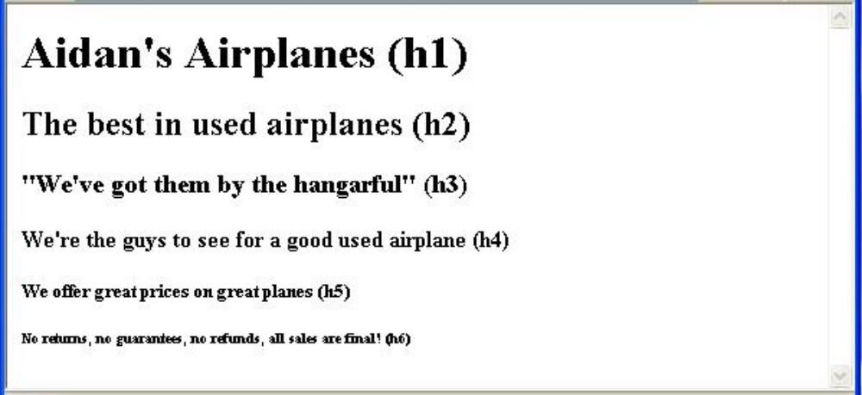
2.4 Basic Text Markup (continued)
- Blockquotes
- Content of <blockquote>
- To set a block of text off from the normal flow and
appearance of text
- Browsers often indent, and sometimes italicize
- Font Styles and Sizes (can be nested)
- Emphasis - <em> (often set in italics)
- Strong - <strong> (often set in boldface)
- Monospace - <code> (often set in Courier)

Slide 9
2.4 Basic Text Markup (continued)
- <em>, <strong>, and <code> are not affected if
they appear in the content of a <blockquote>,
unless there is a conflict (e.g., <em> (italics))
- Superscripts and subscripts
- Subscripts with <sub>
- Superscripts with <sup>
Example: x<sub>2</sub><sup>3</sup>
Display: x₂³
- Inline versus block elements
- Block elements CANNOT be nested in inline
elements (in XHTML)

Slide 10
2.4 Basic Text Markup (continued)
- Character Entities
Char. Entity Meaning
& &amp; Ampersand
< &lt; Less than
> &gt; Greater than
" &quot; Double quote
' &apos; Single quote
¼ &frac14; One quarter
½ &frac12; One half
¾ &frac34; Three quarters
° &deg; Degree
(space) &nbsp; Non-breaking space
@ &copy; Copyright
€ &euro; Euro
- Horizontal rules
- <hr /> draws a line across the display, after a
line break
- The meta element (mainly for search engines)
Used to provide additional information about a
document, with attributes, not content

Slide 11
2.5 Images
- Formats:
- GIF (Graphic Interchange Format)
- 8-bit color (256 different colors)
- JPEG (Joint Photographic Experts Group)
- 24-bit color (16 million different colors)
- Both use compression, but JPEG compression
is better
- Portable Network Graphics (PNG)
- Relatively new
- Should eventually replace both gif and jpeg
- Files are bigger than jpeg – no lost data!
- Images are inserted into a document with the
<img /> tag with the src attribute
- The alt attribute is required by XHTML
- Purposes:
1. Non-graphical browsers
2. Browsers with images turned off
<img src = "comets.jpg"
alt = "Picture of comets" />
- The <img> tag has 30 different attributes, including
width and height (in pixels)

Slide 12
2.5 Images (continued)
<!DOCTYPE html>
<!-- image.html
An example to illustrate an image
-->
<html lang = ″en″>
<head>
<title> Images </title>
<meta charset = ″utf-8″ />
</head>
<body>
<h1> Aidan's Airplanes </h1>
<h2> The best in used airplanes </h2>
<h3> "We've got them by the hangarful"
</h3>
<h2> Special of the month </h2>
<p>
1960 Cessna 210 <br />
577 hours since major engine overhaul
<br />
1022 hours since prop overhaul
<br /><br />
<img src = "c210new.jpg"
alt = "Picture of a Cessna 210"/>
<br />
Buy this fine airplane today at a
remarkably low price <br />
Call 999-555-1111 today!
</p>
</body>
</html>

Slide 13
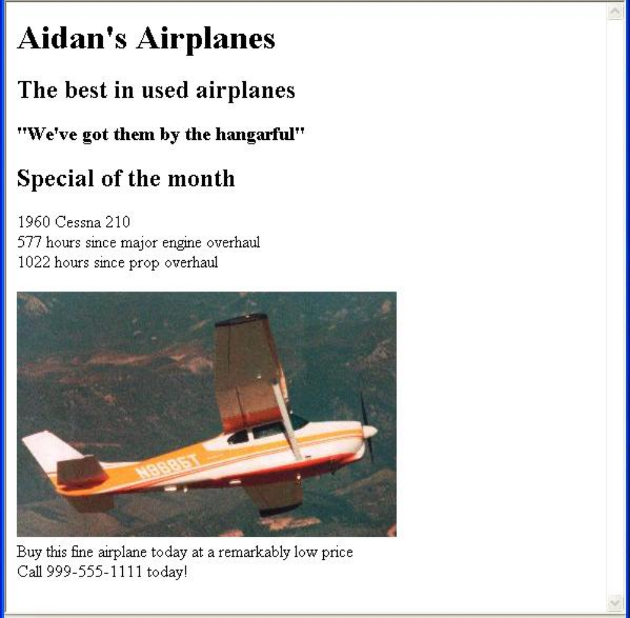
2.5 Images (continued)

Slide 14
2.5 Images (continued)
- HTML Validation
- Replace DOCTYPE with:
<!DOCTYPE html PUBLIC ″//W3C XHTML 1.0 Strict//EN″
″http://www.w3.org/TR/xhtml11/DTD/xhtml1-strict.dtd″
- Replace xmlns value in the html element with:
″ http://www.w3.org/1999/xhtml″
- Comment out the meta element
- Download the validation tool from:
http://totalValidator.com
- Use it on the document
2.6 Hypertext Links
- A link is specified with the href (hypertext
reference) attribute of <a> (the anchor tag)
- The content of <a> is the visual link in the
document
- If the target is a whole document (not the one in
which the link appears), the target need not be
specified in the target document as being the
target

Slide 15
2.6 Hypertext Links (continued)
<!DOCTYPE html>
<!-- link.html
An example to illustrate a link
-->
<html lang = ″en″>
<head>
<title> Links </title>
<meta charset = ″utf-8″ />
</head>
<body>
<h1> Aidan's Airplanes </h1>
<h2> The best in used airplanes </h2>
<h3> "We've got them by the hangarful"
</h3>
<h2> Special of the month </h2>
<p>
1960 Cessna 210 <br />
<a href = "C210data.html">
Information on the Cessna 210 </a>
</p>
</body>
</html>

Slide 16
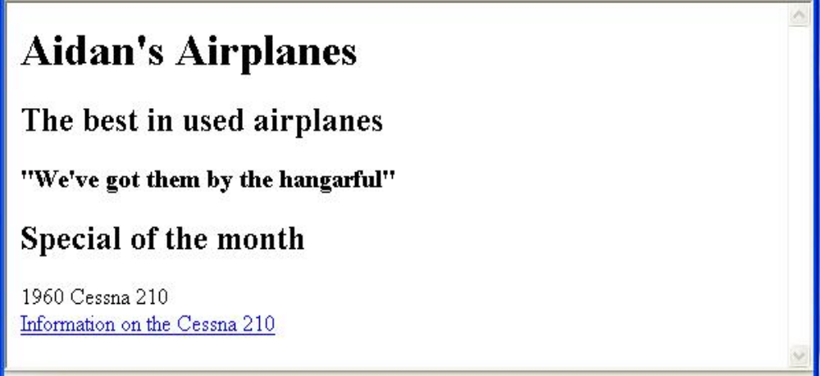
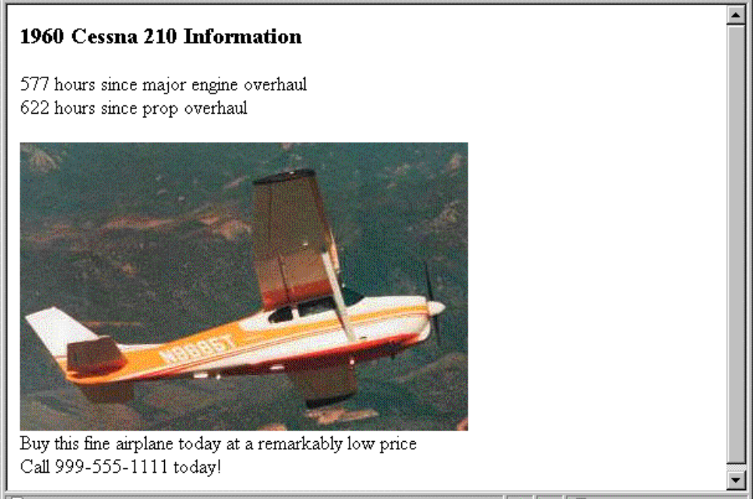
2.6 Hypertext Links (continued)

Slide 17
2.6 Hypertext Links (continued)
- If the target is not at the beginning of the
document, the target spot must be marked
- Target labels can be defined in many different
tags with the id attribute, as in
<h1 id = "baskets"> Baskets </h1>
- The link to an id must be preceded by a pound
sign (#); If the id is in the same document,
this target could be
<a href = "#baskets">
What about baskets? </a>
- If the target is in a different document, the
document reference must be included
<a href = "myAd.html#baskets”> Baskets </a>
- Links can have images:
<a href = "c210data.html">
<img src = "smallplane.jpg"
alt = "Small picture of an airplane" />
Info on C210 </a>

Slide 18
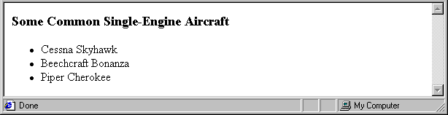
2.7 Lists
- Unordered lists
- The list is the content of the <ul> tag
- List elements are the content of the <li> tag
<h3> Some Common Single-Engine Aircraft </h3>
<ul>
<li> Cessna Skyhawk </li>
<li> Beechcraft Bonanza </li>
<li> Piper Cherokee </li>
</ul>
- Ordered lists
- The list is the content of the <ol> tag
- Each item in the display is preceded by a
sequence value

Slide 19
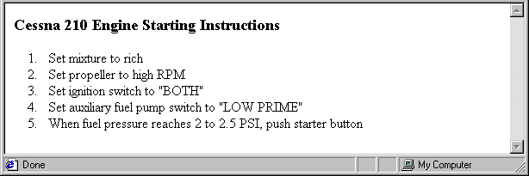
2.7 Lists (continued)
<h3> Cessna 210 Engine Starting Instructions
</h3>
<ol>
<li> Set mixture to rich </li>
<li> Set propeller to high RPM </li>
<li> Set ignition switch to "BOTH" </li>
<li> Set auxiliary fuel pump switch to
"LOW PRIME" </li>
<li> When fuel pressure reaches 2 to 2.5
PSI, push starter button </li>
</ol>
- Nested lists
- Any type list can be nested inside any type list
- The nested list must be in a list item

Slide 20
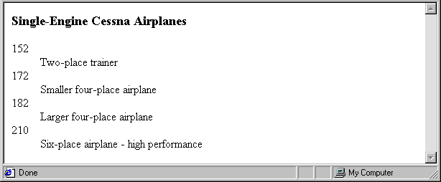
2.7 Lists (continued)
- Definition lists (for glossaries, etc.)
- List is the content of the <dl> tag
- Terms being defined are the content of the
<dt> tag
- The definitions themselves are the content
of the <dd> tag
<h3> Single-Engine Cessna Airplanes </h3>
<dl >
<dt> 152 </dt>
<dd> Two-place trainer </dd>
<dt> 172 </dt>
<dd> Smaller four-place airplane </dd>
<dt> 182 </dt>
<dd> Larger four-place airplane </dd>
<dt> 210 </dt>
<dd> Six-place airplane - high performance
</dd>
</dl>

Slide 21
2.8 Tables
- A table is a matrix of cells, each possibly having
content
- The cells can include almost any element
- Some cells have row or column labels and
some have data
- A table is specified as the content of a <table>
tag
- In HTML5, tables do not have lines between the
rows or between the columns
- We can add those with Cascading Style Sheets,
as will be discussed in Chapter 3
- Tables are given titles with the <caption> tag,
which can immediately follow <table>

Slide 22
2.8 Tables (continued)
- Each row of a table is specified as the content of
a <tr> tag
- The row headings are specified as the content of
a <th> tag
- The contents of a data cell is specified as the
content of a <td> tag
<table>
<caption> Fruit Juice Drinks </caption>
<tr>
<th> </th>
<th> Apple </th>
<th> Orange </th>
<th> Screwdriver </th>
</tr>
<tr>
<th> Breakfast </th>
<td> 0 </td>
<td> 1 </td>
<td> 0 </td>
</tr>
<tr>
<th> Lunch </th>
<td> 1 </td>
<td> 0 </td>
<td> 0 </td>
</tr>
</table>

Slide 23
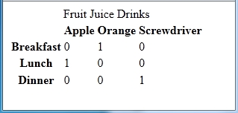

2.8 Tables (continued)
- A table can have two levels of column labels
- If so, the colspan attribute must be set in the
<th> tag to specify that the label must span
some number of columns
<tr>
<th colspan = "3"> Fruit Juice Drinks </th>
</tr>
<tr>
<th> Orange </th>
<th> Apple </th>
<th> Screwdriver </th>
</tr>

Slide 24
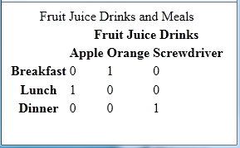
2.8 Tables (continued)
- If the rows have labels and there is a spanning
column label, the upper left corner must be
made larger, using rowspan
<table>
<tr>
<td rowspan = "2"> </td>
<th colspan = "3"> Fruit Juice Drinks
</th>
</tr>
<tr>
<th> Apple </th>
<th> Orange </th>
<th> Screwdriver </th>
</tr>
…
</table>

Slide 25
2.8 Tables (continued)
- Table Sections
- Header, body, and footer, which are the elements:
thead, tbody, and tfoot
- If a document has multiple tbody elements, they
are separated by thicker horizontal lines
- Uses of Tables
- In the past, tables were used to align elements in
rows and columns – general layout
- That use of tables is now frowned upon
- Use Cascading Style Sheets to place elements in
rows and columns – general layout
- Use tables only when the information is naturally
tabular

Slide 26
2.9 Forms
- A form is the usual way information is gotten from
a browser user to a server
- HTML has tags to create a collection of objects that
implement this information gathering
- The objects are called widgets or controls or
components
- When the Submit button of a form is clicked, the
form’s values are sent to the server for processing
- All of the widgets, or components of a form are
defined in the content of a <form> tag
- The only required attribute of <form> is action,
which specifies the URL of the application that is
to be called when the Submit button is clicked
(XHTML requires it; HTML does not)
action =
"http://www.cs.ucp.edu/cgi-bin/survey.pl"
- If the form has no action, the value of action is
the empty string

Slide 27
2.9 Forms (continued)
- The method attribute of <form> specifies one of
the two possible techniques of transferring the
form data to the server, get and post
- The default is get
- get and post are discussed in Chapter 10
- Widgets
- Many are created with the <input> tag
- The type attribute of <input> specifies the kind
of widget being created
1. Text
- Creates a horizontal box for text input
- Default size is 20; it can be changed with the
size attribute
- If more characters are entered than will fit, the
box is scrolled (shifted) left

Slide 28
2.9 Forms (continued)
- If you don’t want to allow the user to type more
characters than will fit, set maxlength, which
causes excess input to be ignored
<input type = "text" name = "Phone"
size = "12" />
- Widgets should be placed in label elements
<label> Phone: <input type = "text"
name = "phone" />
</label>
2. Password – just like text except asterisks are
displayed, rather than the input characters
3. Checkboxes - to collect multiple choice input
- Every checkbox requires a value attribute,
which is the widget’s value in the form data
when the checkbox is ‘checked’
- A checkbox that is not ‘checked’ contributes
no value to the form data
- By default, no checkbox is initially ‘checked’
- To initialize a checkbox to ‘checked’, the
checked attribute must be set to "checked"

Slide 29
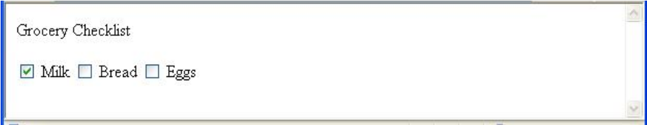
2.9 Forms (continued)
- Widgets (continued)
Grocery Checklist
<form action = "">
<p>
<label> <input type = "checkbox" name ="groceries"
value = "milk" checked = "checked" />
Milk </label>
<label> <input type = "checkbox" name ="groceries"
value = "bread“ />
Bread </label>
<label> <input type = "checkbox" name = "groceries"
value= "eggs" />
Eggs </label>
</p>
</form>
4. Radio Buttons - collections of checkboxes in
which only one button can be ‘checked’ at a
time
- Every button in a radio button group MUST
have the same name

Slide 30
2.9 Forms (continued)
- Widgets (continued)
4. Radio Buttons (continued)
- If no button in a radio button group is
‘pressed’, the browser often ‘presses’ the
first one
Age Category
<form action = "">
<p>
<label> <input type = "radio" name = "age"
value = "under20" checked = "checked" />
0-19 </label>
<label> <input type = "radio" name = "age"
value = "20-35" /> 20-35 </label>
<label> <input type = "radio" name = "age"
value = "36-50" /> 36-50 </label>
<label> <input type = "radio" name = "age"
value = "over50" /> Over 50 </label>
</p>
</form>

Slide 31
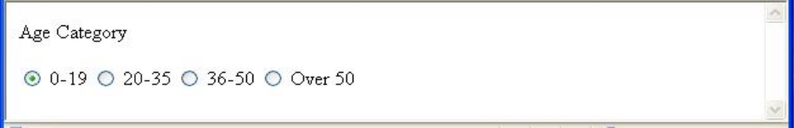
2.9 Forms (continued)
Widgets (continued)
5. The <select> tag
- There are two kinds of menus, those that
behave like checkboxes and those that
behave like radio buttons (the default)
- Menus that behave like checkboxes are
specified by including the multiple attribute,
which must be set to "multiple"
- The name attribute of <select> is required
- The size attribute of <select> can be
included to specify the number of menu
items to be displayed (the default is 1)
- If size is set to > 1 or if multiple is
specified, the menu is displayed as a
pop-up menu

Slide 32
2.9 Forms (continued)
- Widgets (continued)
5. <select> (continued)
- Each item of a menu is specified with an
<option> tag, whose pure text content
(no tags) is the value of the item
- An <option> tag can include the selected
attribute, which when assigned "selected"
specifies that the item is preselected
Grocery Menu - milk, bread, eggs, cheese
<form action = "">
<p>
With size = 1 (the default)
<select name = "groceries">
<option> milk </option>
<option> bread </option>
<option> eggs </option>
<option> cheese </option>
</select>
</p>
</form>

Slide 33
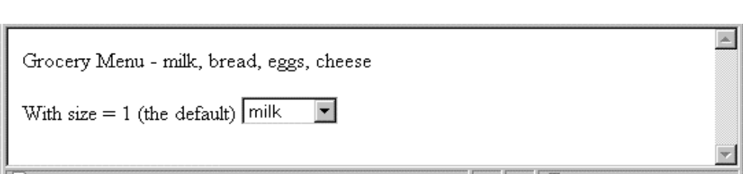
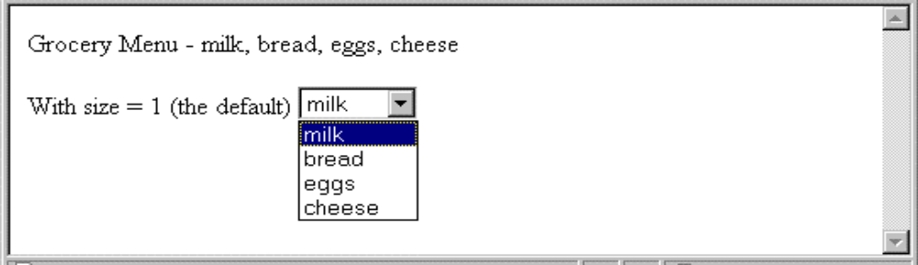
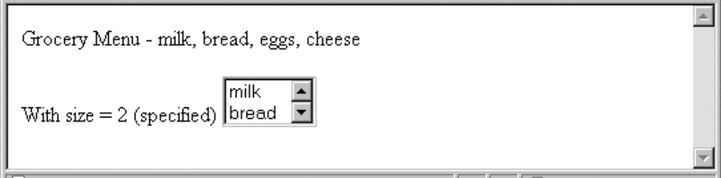
2.9 Forms (continued)
- Widgets (continued)
- After clicking the menu:
- After changing size to 2:

Slide 34
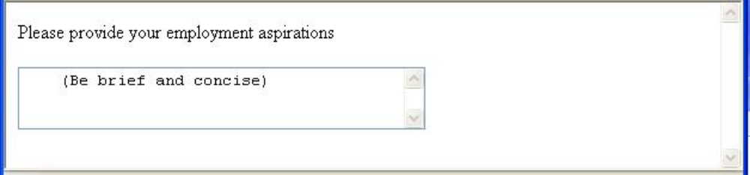
2.9 Forms (continued)
Widgets (continued)
6. Text areas - created with <textarea>
- Usually include the rows and cols attributes
to specify the size of the text area
- Default text can be included as the content of
<textarea>
- Scrolling is implicit if the area is overfilled
Please provide your employment aspirations
<form action = "">
<p>
<textarea name = "aspirations" rows = "3”
cols = "40">
(Be brief and concise)
</textarea>
</p>
</form>

Slide 35
2.9 Forms (continued)
- Widgets (continued)
7. Action buttons
- Both are created with <input>
<input type = "reset"
value = "Reset Form" />
<input type = "submit”
value = "Submit Form" />
- Submit has two actions:
1. Encode the data of the form
2. Request that the server execute the
server-resident program specified as the
value of the action attribute of <form>
- A Submit button is required in every form
→SHOW popcorn.html and display it

Slide 36
2.10 The audio Element
- Prior to HTML5, a plug-in was required to play
sound while a document was being displayed
- Audio encoding algorithms are called audio
codecs – e.g., MP3, Vorbis
- Coded audio data is stored in containers—e.g.,
Ogg, MP3, and Wav (file name extension indicates
the container, not the audio code)
- Vorbis code is stored in Ogg containers
- MP3 code is stored in MP3 containers
- Wav code is stored in Wav containers

Slide 37
2.10 The audio Element (continued)
- General syntax:
<audio attributes>
<source src = "filename₁" >
...
<source src = "filename_{n}" >
Your browser does not support the audio
element
</audio>
- Browser chooses the first audio file it can play
and skips the content; if none, it displays the
content
- Different browsers have different audio
capabilities
- The controls attribute, which is set to controls",
creates a start/stop button, a clock, a progress
slider, total time of the file, and a volume slider

Slide 38
2.10 The audio Element (continued)
<!DOCTYPE html>
<!– audio.html
Test the audio element
-->
<html lang = "en" >
<head>
<title> Test audio element </title>
<meta charset = "utf-8" />
</head>
<body>
This is a test of the audio element
<audio controls = "controls" >
<source src = "nineoneone.ogg" />
<source src = "nineoneone.wav" />
<source src = "nineoneone.mp3" />
Your browser does not support the audio
element
</audio>
</body>
</html>

Slide 39
2.11 The video Element
- Prior to HTML5, there was no standard way to
play video clips while a document was being
displayed
- Video codecs are stored in containers
- Video codecs:
H.264 (MPEG-4 AVC) – can be stored in MPEG-4
Theora – can be stored in any container
VP8—can be stored in any container
- Different browsers support different codecs
- The width and height attributes set the screen
size
- The autoplay attribute, set to "autoplay",
specifies that the video should play as soon as
it is ready
- The preload attribute, set to "preload",
specifies that the video should be loaded as
soon as the document is loaded
-The controls attribute, set to "controls", is like
that of the audio element

Slide 40
2.11 The video Element (continued)
<!DOCTYPE html>
<!-- testvideo.html
test the video element
-->
<html lang = "en">
<head>
<meta charset = "UTF-8" />
<title> test video element </title>
</head>
<body>
This is a test of the video element.....
<video width = "600" height = "500"
autoplay = "autoplay"
controls = "controls"
preload = "preload">
<source src = "NorskTippingKebab.mp4" />
<source src = "NorskTippingKebab.ogv" />
<source src = "NorskTippingKebab.webm" />
Your browser does not support the video
element
</video>
</body>
</html>

Slide 41
2.12 Organization Elements
- Header Elements
- hgroup – a container for header information
<hgroup>
<header>
<h1> The Podunk Press </h1>
<h2> ″All the news we can fit″ </h2>
</header>
-- table of contents –
</hgroup>
- Footer Elements
- footer – a container for footer information
<footer>
&copy; The Podunk Press, 2012
<br />
Editor in Chief: Squeak Martin
</footer>
- The section Element – a container for sections
- The article Element – a container for
self-contained part of a document (from another
source)
- The aside Element – a container for tangential info
- The nav Element – navigation sections (list of links)

Slide 42
2.13 The time Element
- For putting a time stamp on a document
- Two parts, text and machine-readable (datetime)
- datetime attribute (optional) – the
machine-readable part
- Date part: 4-digit year, a dash, 2-digit month, a
dash, 2-digit day of the month (″2012-08-29”)
- Time (optional) format: T09:00
- Text part is given as the content of time
<time datetime = ″2012-08-29T09:00″>
August 8, 2012 9:00 am
</time>
- The two parts need not specify the same date
- Deficiencies:
1. Dates prior to the Christian era are not
possible
2. No approximations

Slide 43
2.14 Syntactic Differences between
HTML & XHTML
- Case sensitivity
- Closing tags
- Quoted attribute values
- Explicit attribute values
- id and name attributes
- Element nesting

